Slide 1
MONOPOLY
Ashlyn Ramos, Justin Schaumberger, Andrew Lee, Kerri Palphreyman

Slide 2
Rules
2-4 players all start with $1500
Players roll 2 dices and interact with whatever space they land on (purchasing, paying rent to owner, drawing cards, etc.)
If a player rolls a double, they roll again, and if 3 doubles are rolled consecutively they go to Jail
If a player is in Jail and they roll a double they can move out of Jail
If a player runs out of money they are out of the game

Slide 3
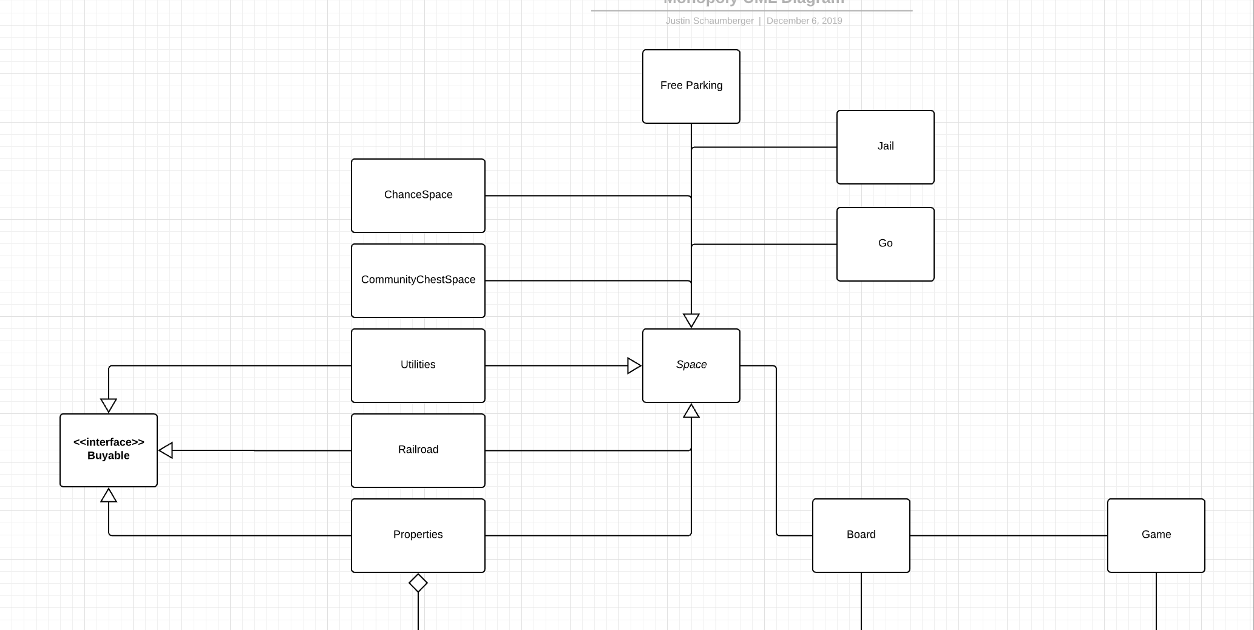

Slide 4
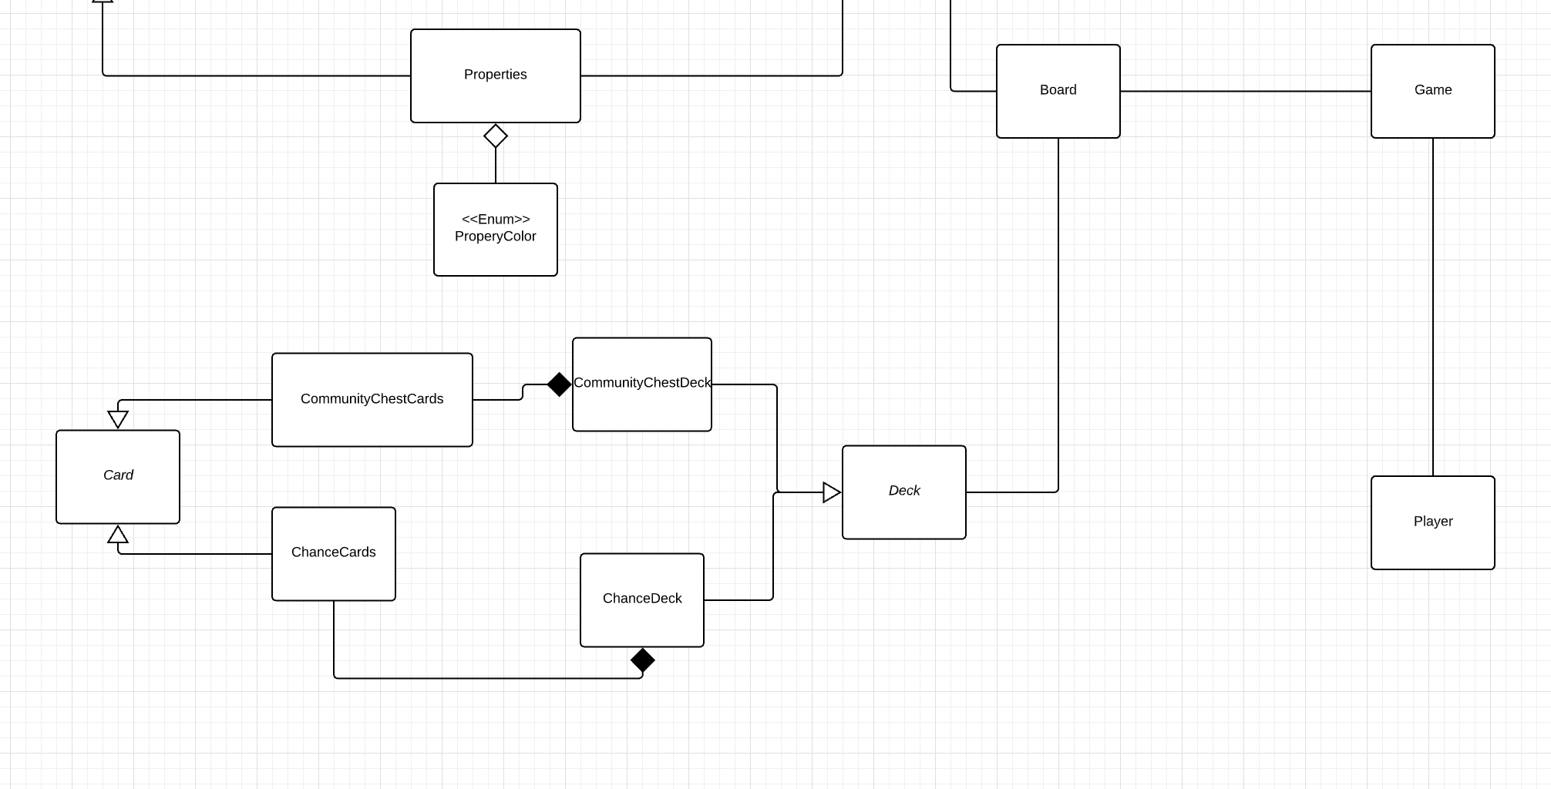

Slide 5
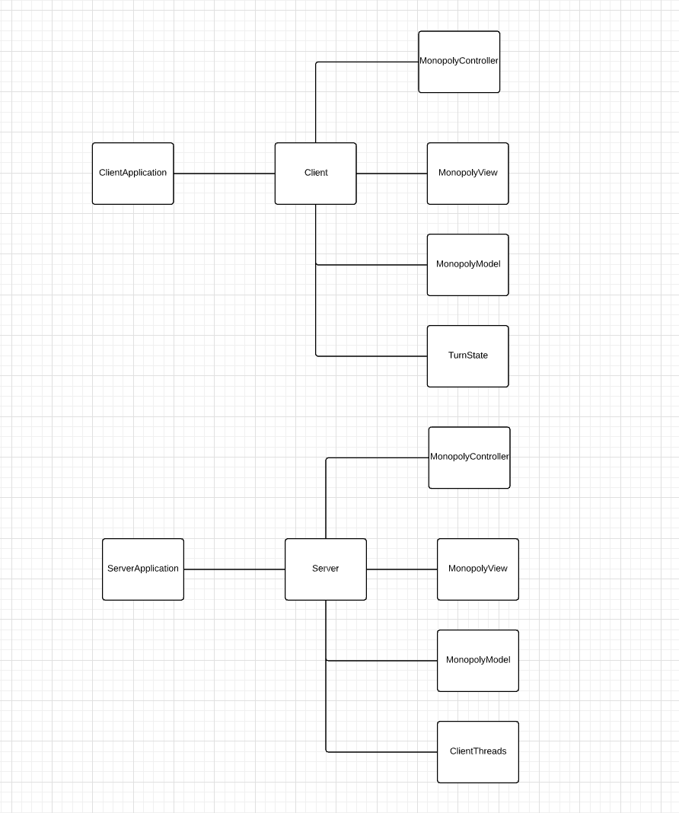

Slide 6
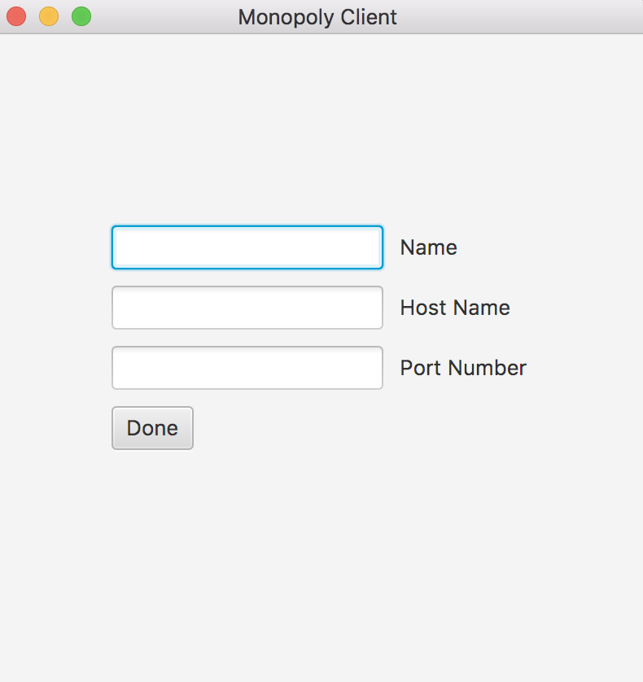
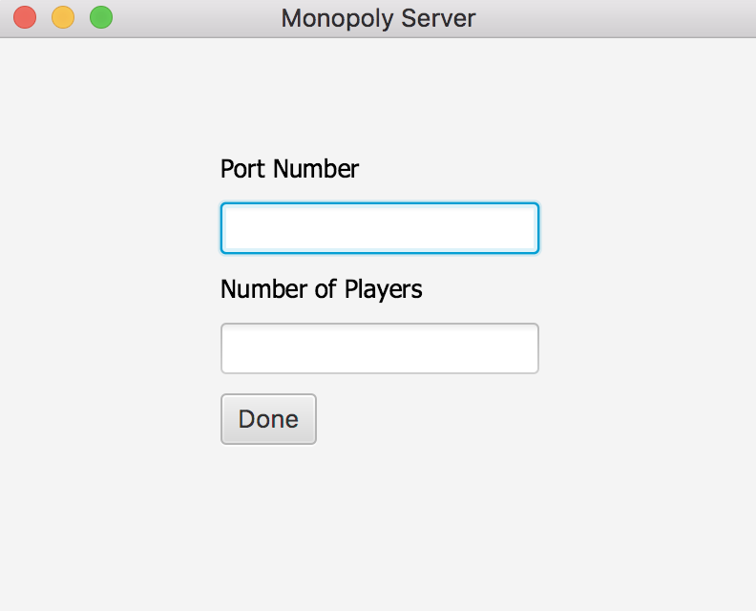
Game setup

Slide 7
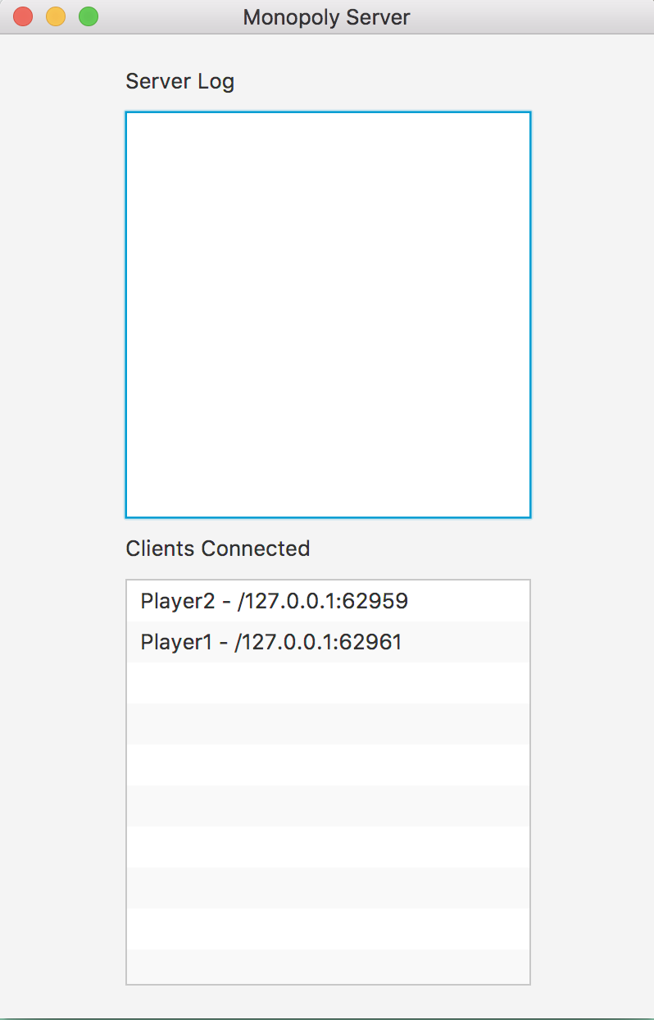
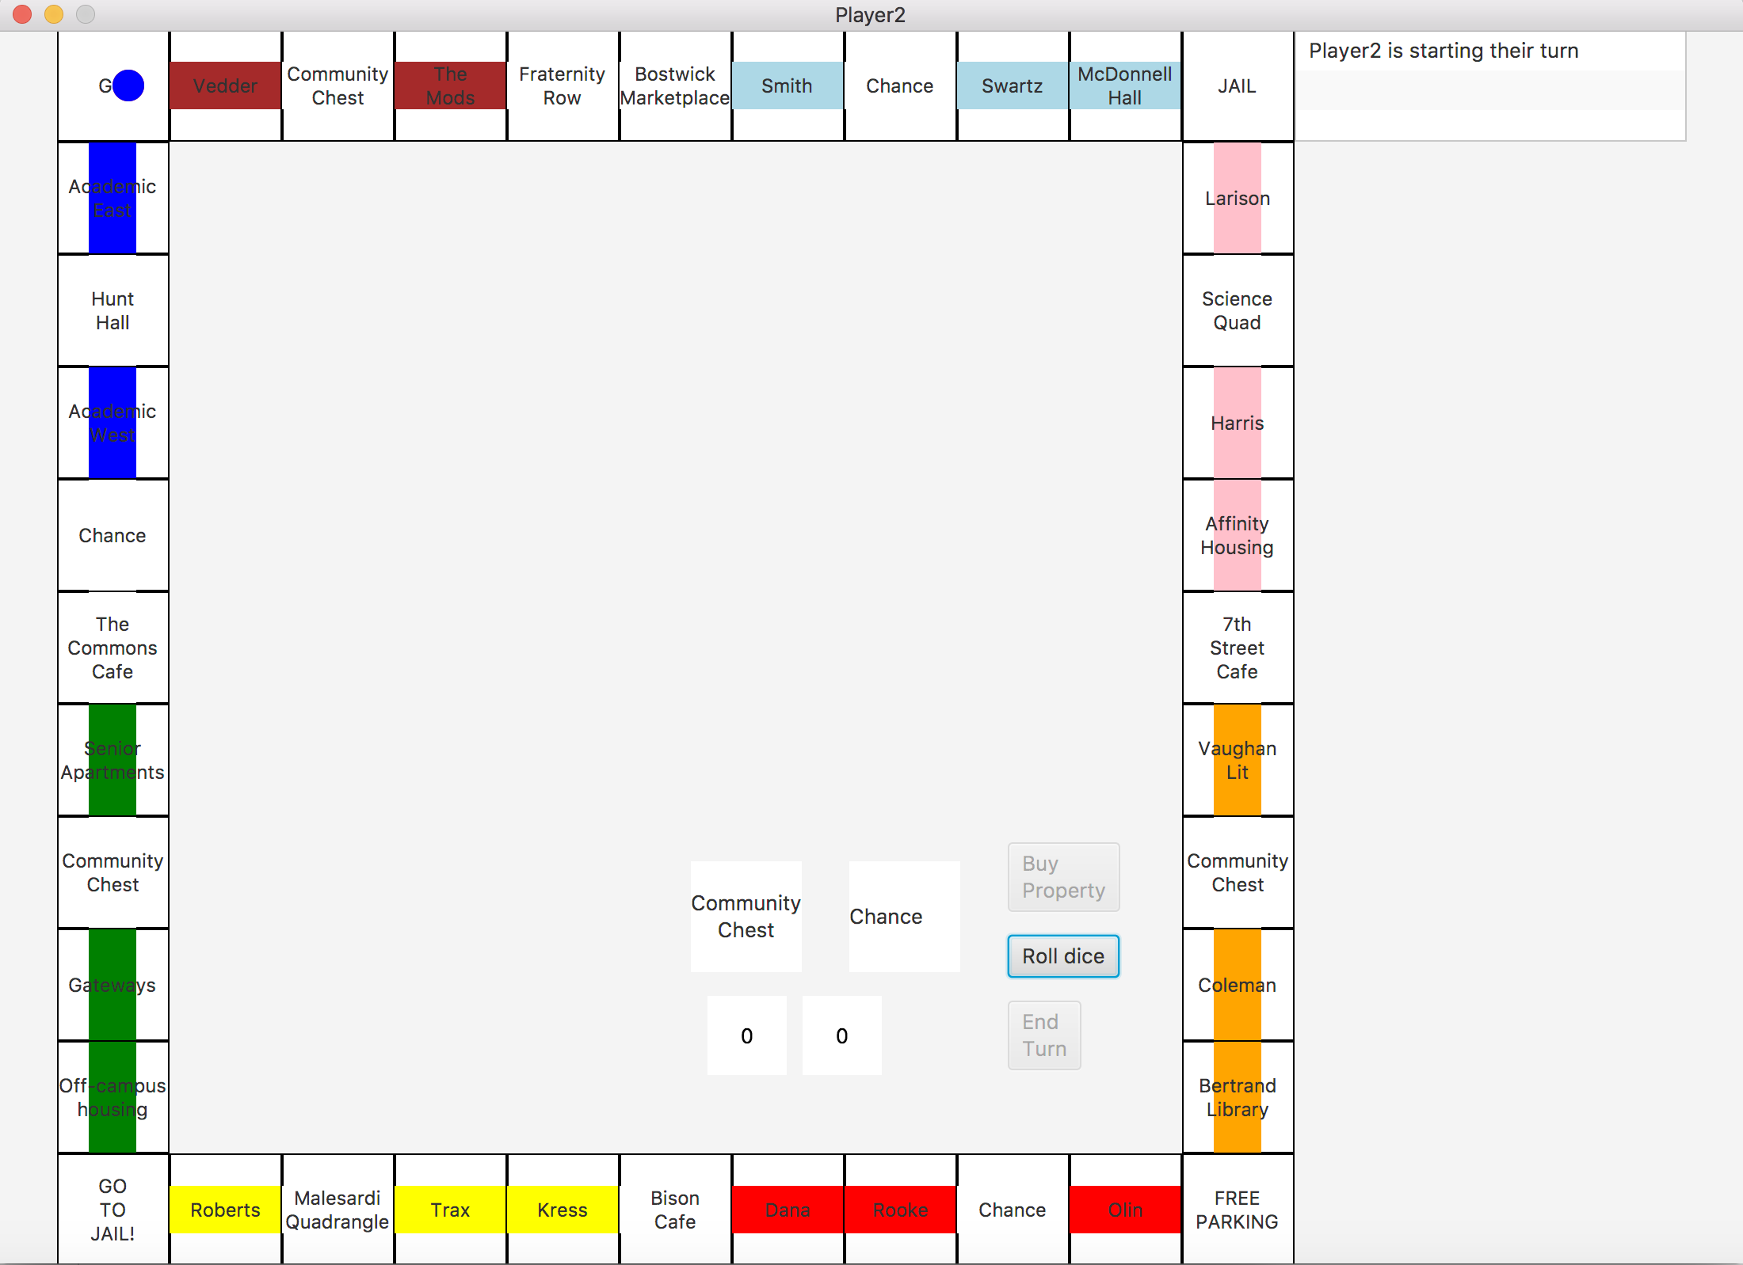
Gameplay
Add screenshot of game once running

Slide 8
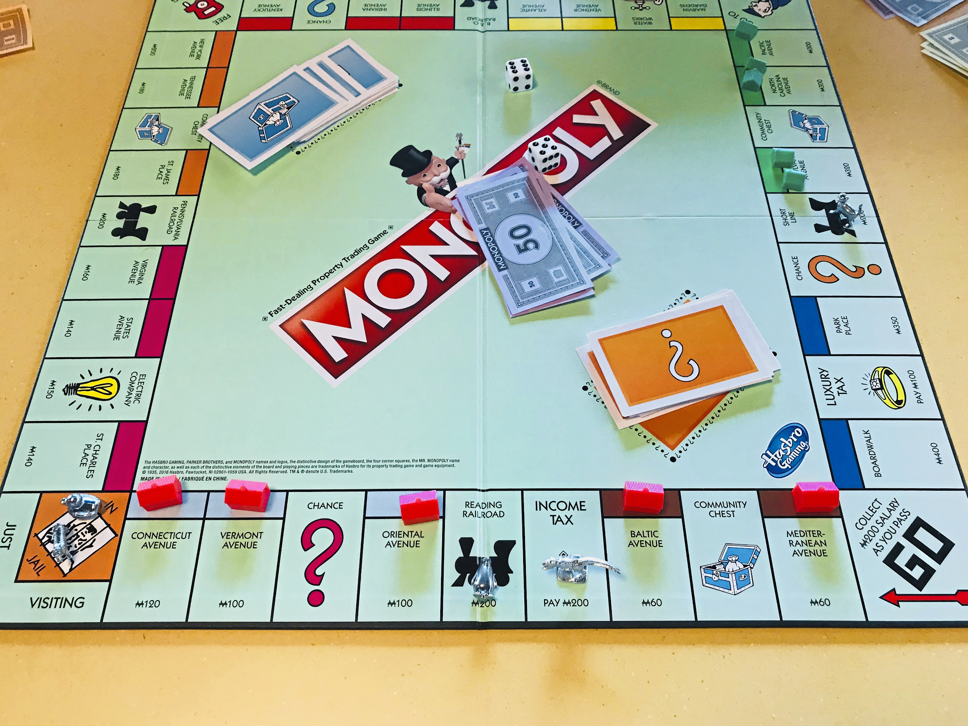
Demonstration

Slide 9
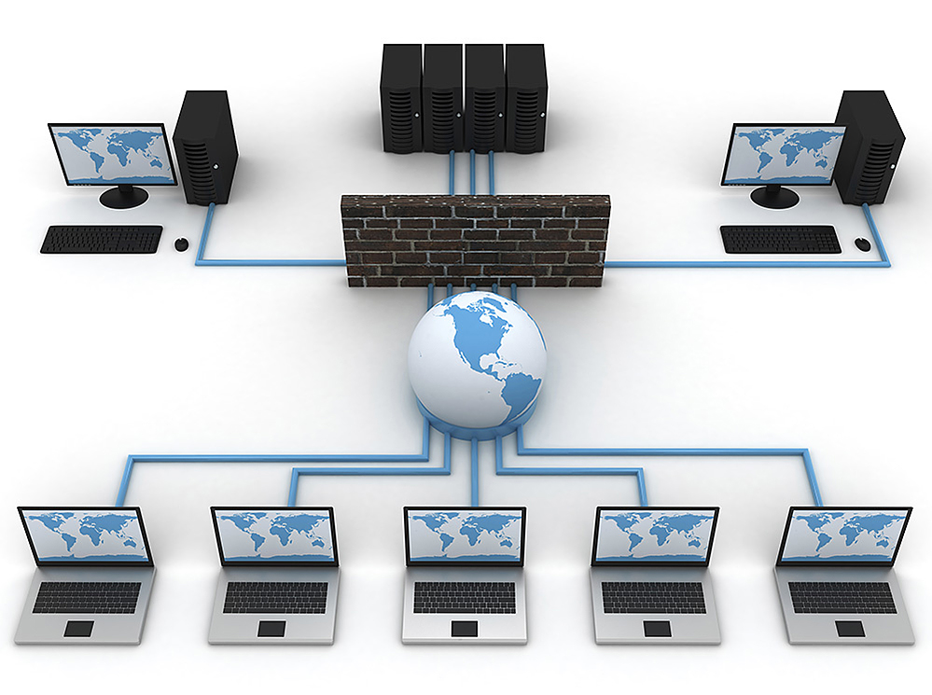
Biggest Challenge
Notes:
Networking!!!!!!

Slide 10
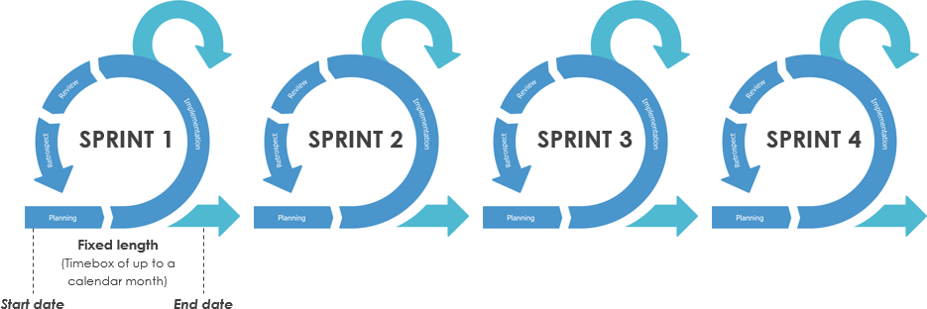
Our Experience with Scrum
Notes:
Sprint 1 - Creating the board and characters (Properties, spaces, moveable characters)
Sprint 2 - Creating different capabilities for players in the game
Sprint 3 - Networking
Sprint 4 - Alternating turns between players in networking and graphics

Slide 11

Biggest Scrum Strength
Notes:
Communication
Texting back and forth
Good comments on codee

Slide 12

Biggest Scrum Weakness
Notes:
Planning out our sprints (time estimations)
Understanding each other’s code (made easier by good comments)
Inability to test everything (There are almost infinitely many possibilities for what can happen in a game)

Slide 13

What We Learned
Notes:
We learned about the difficulties of networking and organizing and planning work out in advance (Scrum)
Give examples

Slide 14
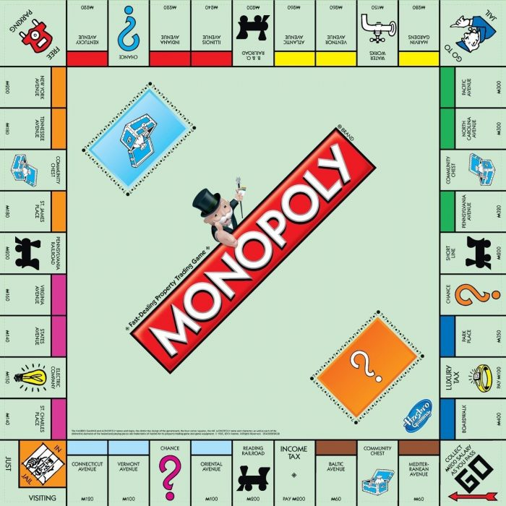
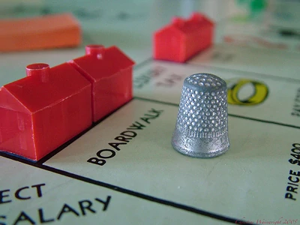
Version 2.0
Notes:
Version 2.0 would include better animations, ability to monopolize and mortgage, and a single player option

Slide 15
Work Cited
https://liber.post-gazette.com/.media/2/2018/08/20/3a3f6fa4-df73-4af3-91be-f5f013a8110f.jpg
https://www.visual-paradigm.com/servlet/editor-content/scrum/why-fixed-length-of-sprints-in-scrum/sites/7/2018/11/sprints-in-scrum.png
http://news.mit.edu/sites/mit.edu.newsoffice/files/images/2013/20130718134421-0_0.jpg
https://media.boingboing.net/wp-content/uploads/2018/12/Monopoly-e1545959207308.jpg
https://vignette.wikia.nocookie.net/monopoly/images/d/d9/Monopoly4.jpg/revision/latest?cb=20110525224529
https://www.csee.umbc.edu/wp-content/uploads/2012/10/Computer-Science-Help-Center.jpg
https://cs.stanford.edu/sites/default/files/carousel_images/chalkboard_web.jpg
https://www.qualtrics.com/m/assets/blog/wp-content/uploads/2018/08/shutterstock_1068141515.jpg

